Slide 1
Chapter 3: Primary Energy Conversion

Slide 2
Primary energy sources
Renewable sources
Wind
Solar
Geothermal
Wave
Tidal
Fossil fuels
Nuclear
Coal
Gas
Oil

Slide 3
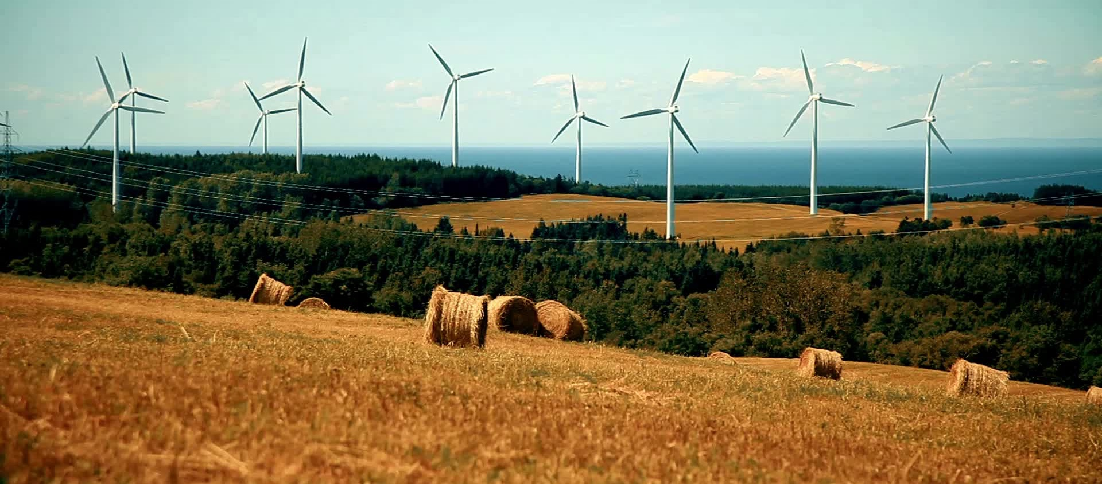
Wind generation

Slide 4
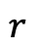
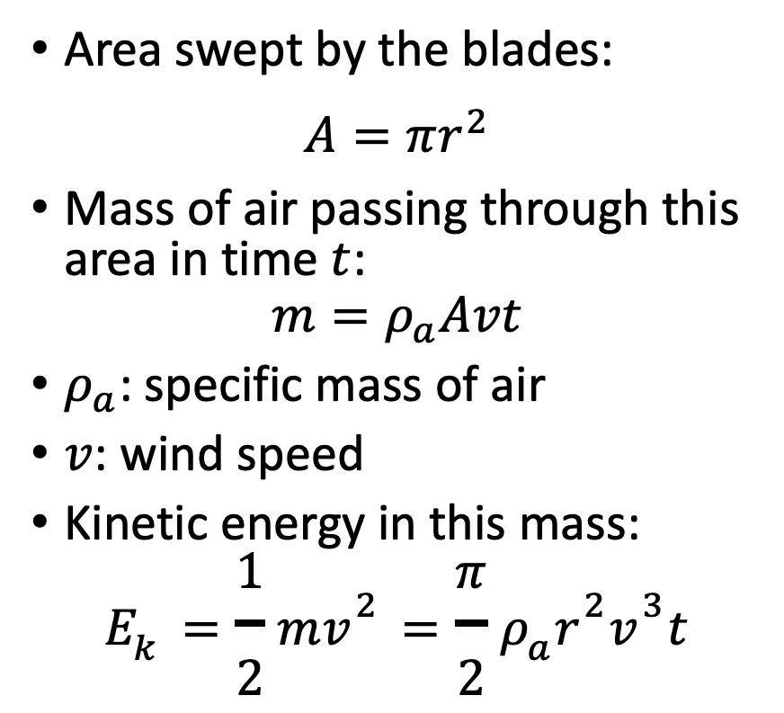
How much energy is there in the wind?
Area swept by the blades:
$A=πr^{2}$
Mass of air passing through this area in time $t$:
$$m=ρ_{a}Avt$$
$ρ_{a}$: specific mass of air
$v$: wind speed
Kinetic energy in this mass:
$$E_{k}=\frac{1}{2}mv^{2}=\frac{π}{2}ρ_{a}r^{2}v^{3}t$$
$$r$$

Slide 5
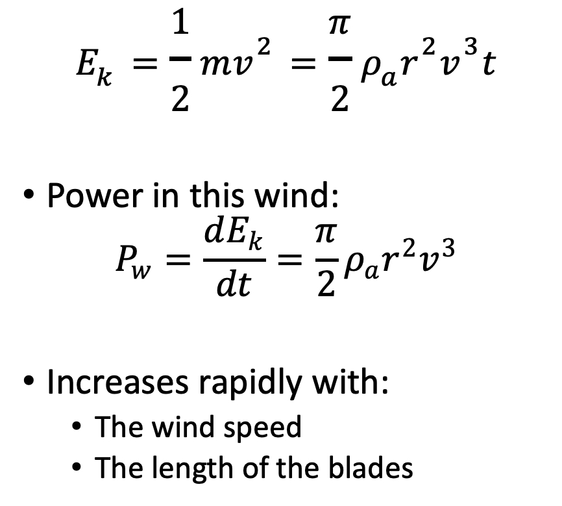
How much power is there in the wind?
$$E_{k}=\frac{1}{2}mv^{2}=\frac{π}{2}ρ_{a}r^{2}v^{3}t$$
Power in this wind:
$$P_{w}=\frac{dE_{k}}{dt}=\frac{π}{2}ρ_{a}r^{2}v^{3}$$
Increases rapidly with:
The wind speed
The length of the blades
$$r$$

Slide 6
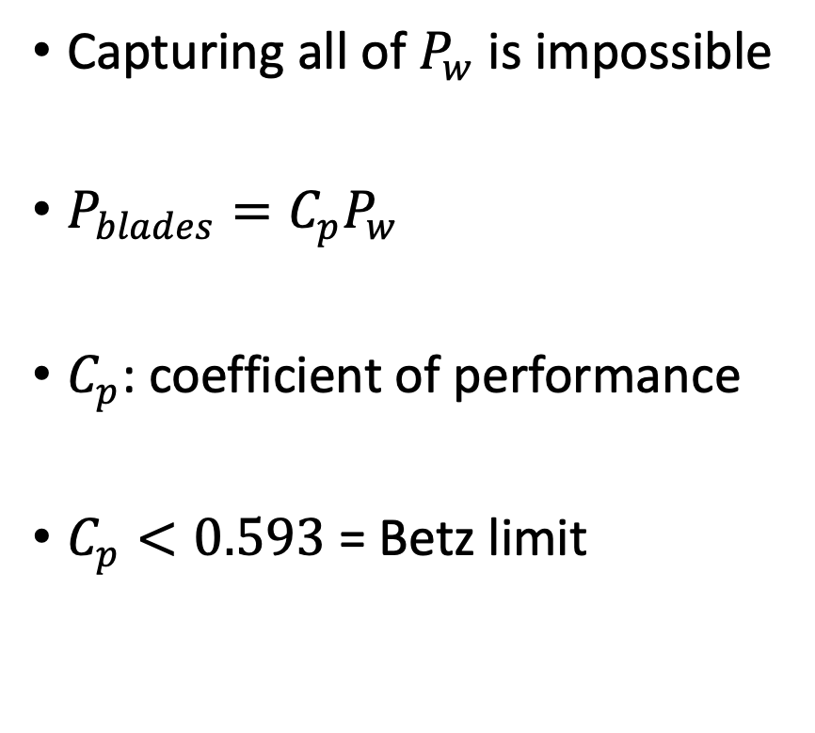
How much power can be captured?
Capturing all of $P_{w}$ is impossible
$P_{blades}=C_{p}P_{w}$
$C_{p}$: coefficient of performance
$C_{p}<0.593$ = Betz limit
$$r$$

Slide 7
Flow of air around an airfoil
Airfoil pushed up
Airflow deflected down

Slide 8
Lift force
Airfoil deflects the airflow down
Airfoil exerts a downward force on the air
Newton’s third law: action – reaction
Air exerts an upward force on the airfoil
This lift force makes it possible for airplanes to fly

Slide 9
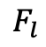
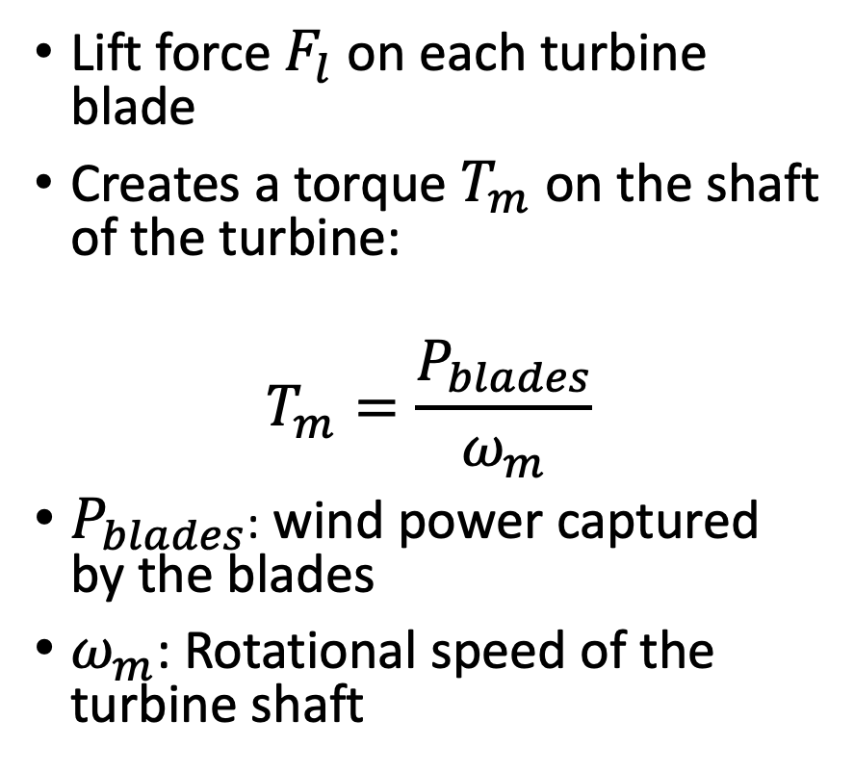
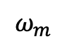
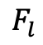
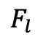
Torque
Lift force $F_{l}$on each turbine blade
Creates a torque $T_{m}$ on the shaft of the turbine:
$$T_{m}=\frac{P_{blades}}{ω_{m}}$$
$P_{blades}$: wind power captured by the blades
$ω_{m}$: Rotational speed of the turbine shaft
$$F_{l}$$
$$ω_{m}$$
$$F_{l}$$
$$F_{l}$$

Slide 10
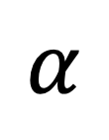

Angle of attack $α$
Chord of the airfoil
$$α$$
Wind direction

Slide 11
Lift force vs. angle of attack α
Lift force
Angle at zero lift
α

Slide 12
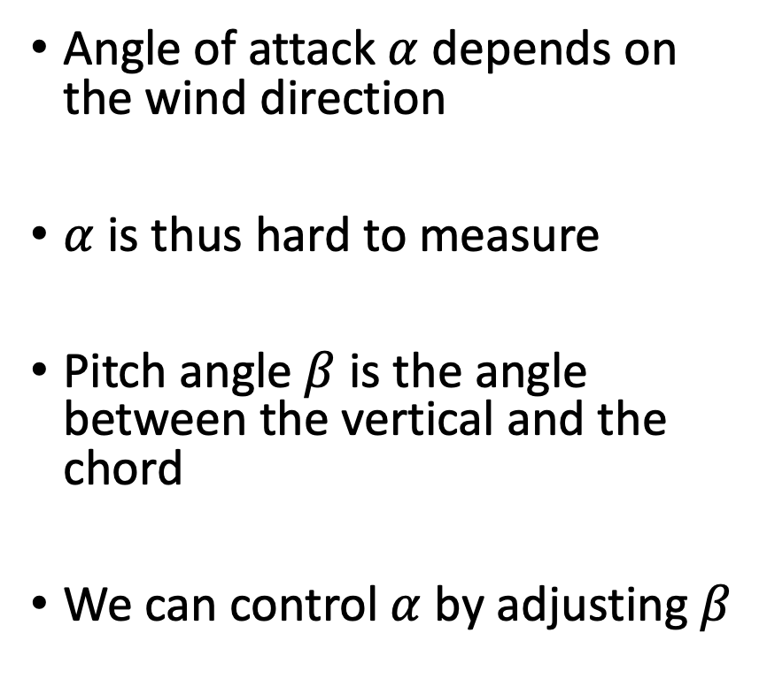

Pitch angle $β$
Angle of attack $α$ depends on the wind direction
$α$ is thus hard to measure
Pitch angle $β$ is the angle between the vertical and the chord
We can control $α$ by adjusting $β$

Slide 13
Controlling the pitch angle
Pitch angle can be adjusted by rotating the blade where it connects to the shaft

Slide 14
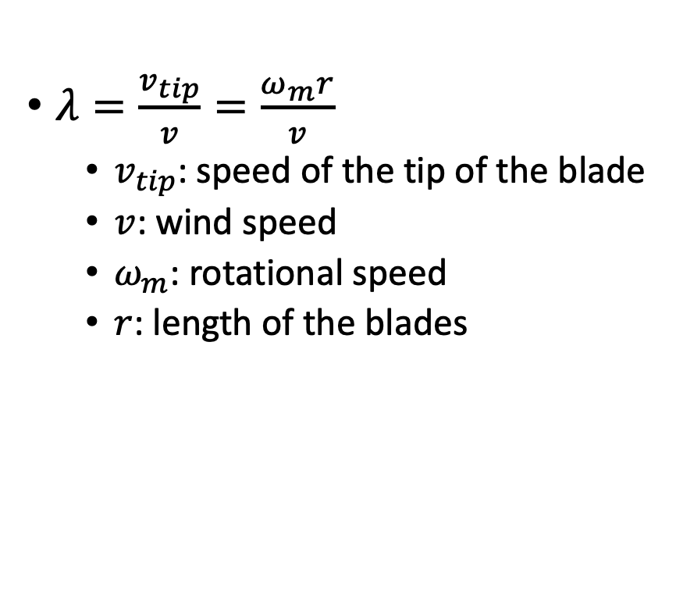
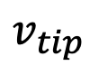

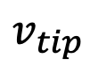
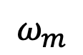
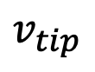
Tip speed ratio $λ$
$$v_{tip}$$
$λ=\frac{v_{tip}}{v}=\frac{ω_{m}r}{v}$
$v_{tip}$: speed of the tip of the blade
$v$: wind speed
$ω_{m}$: rotational speed
$r$: length of the blades
$$ω_{m}$$
$$v_{tip}$$
$$v_{tip}$$

Slide 15
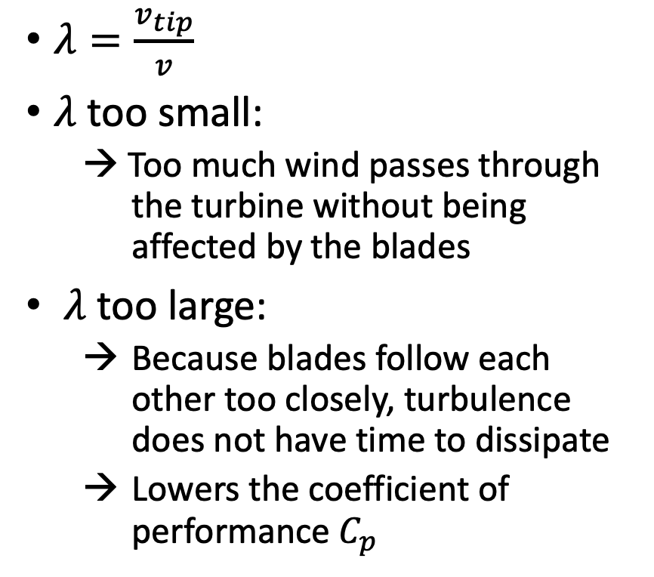

Optimal tip speed ratio $λ$
$$v_{tip}$$
$λ=\frac{v_{tip}}{v}$
$λ$ too small:
→ Too much wind passes through the turbine without being affected by the blades
$λ$ too large:
Because blades follow each other too closely, turbulence does not have time to dissipate
Lowers the coefficient of performance $C_{p}$
$$ω_{m}$$
$$v_{tip}$$
$$v_{tip}$$

Slide 16

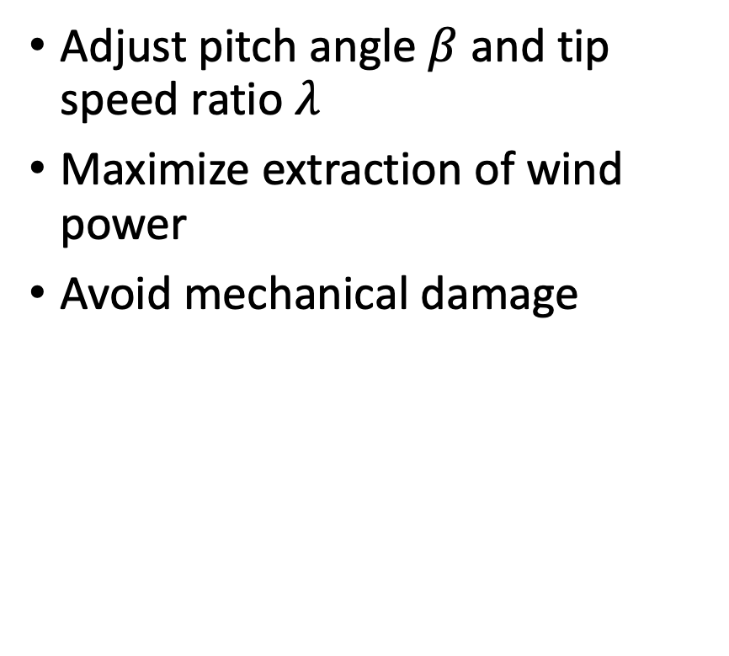
Controlling a wind turbine
Adjust pitch angle $β$ and tip speed ratio $λ$
Maximize extraction of wind power
Avoid mechanical damage

Slide 17
Power vs. wind speed characteristic
Power
Wind power
Turbine Power
Rated
Power
Ramp up
Ramp down
Cut-in speed
Cut-out speed
Wind speed

Slide 18
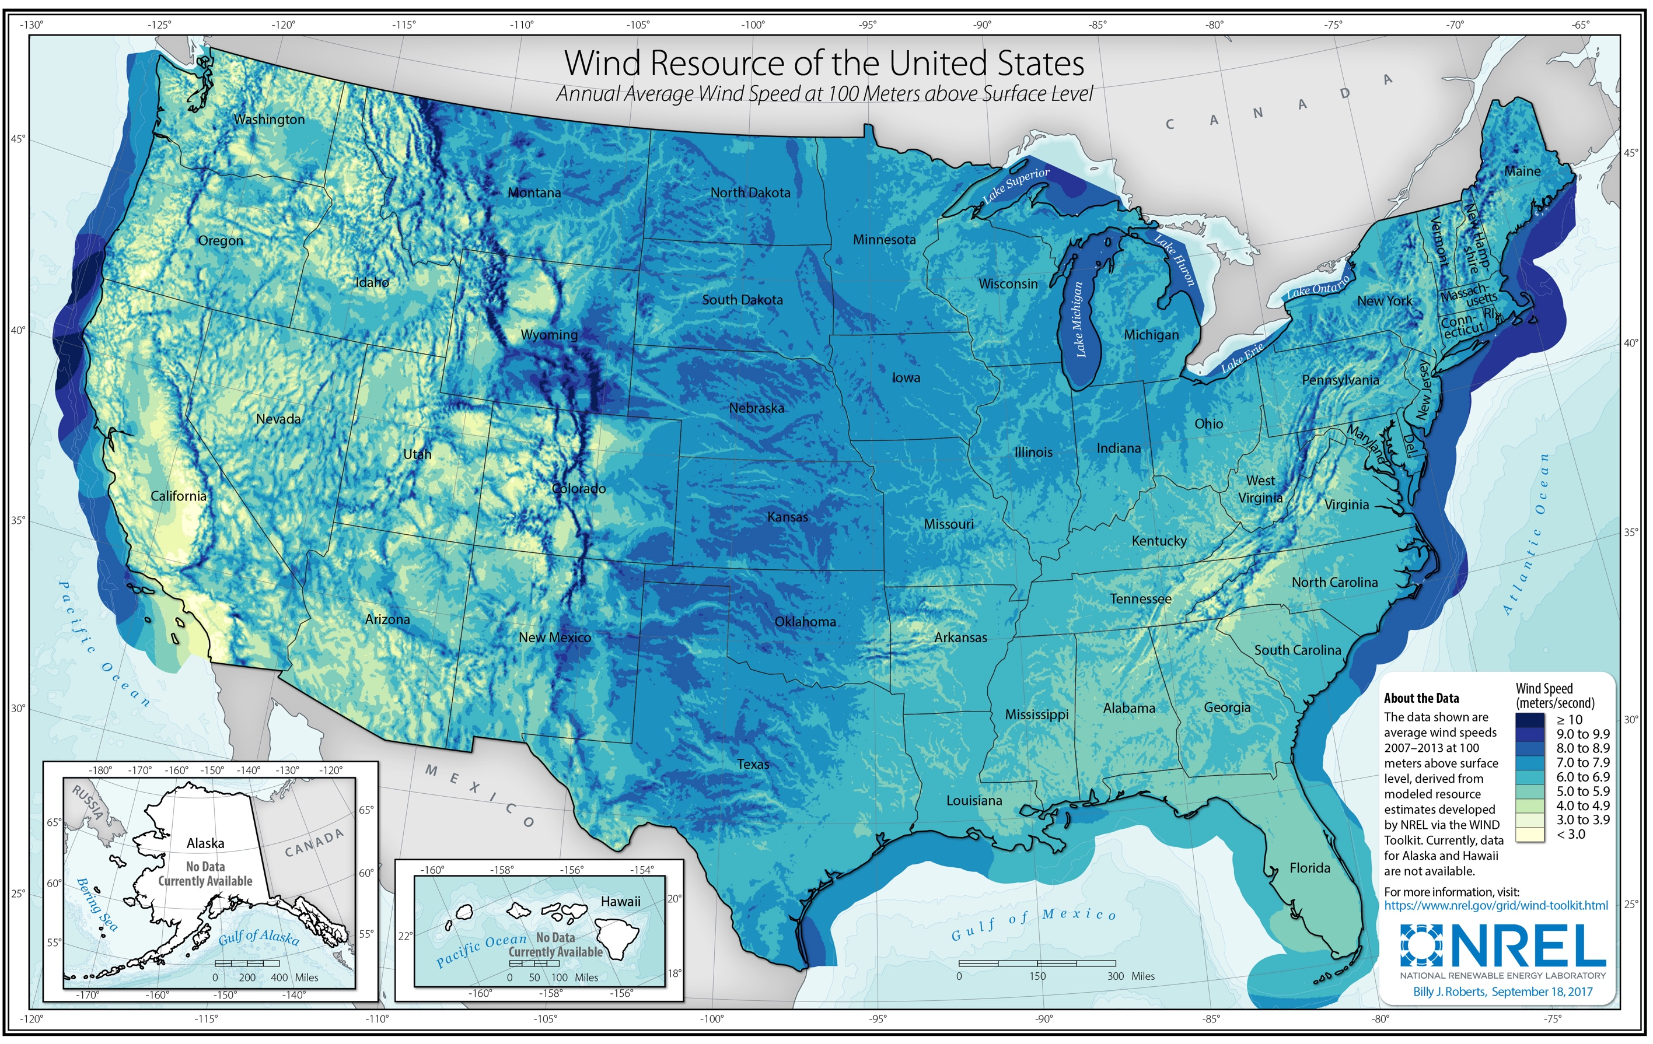
Wind resource of the United States.
Source: C. Draxl, B.M. Hodge, A. Clifton, and J. McCaa. 2015. Overview and Meteorological Validation of the Wind Integration National Dataset Toolkit,
Technical Report, NREL/TP-5000-61740. Golden, CO: National Renewable Energy Laboratory.

Slide 19
Variability of wind generation
Percentage of the aggregated load in the ERCOT system supplied by wind generation on November 16, 2018
Rather extreme day
Variability must be compensated by other sources
Source: http://www.ercot.com

Slide 20
Histogram of wind generation output
Histogram of the wind generation output in the ERCOT system in 2018
Overall wind generation capacity factor for 2018: 36.6%
Frequency
Percentage of wind generation capacity
Source: http://www.ercot.com

Slide 21
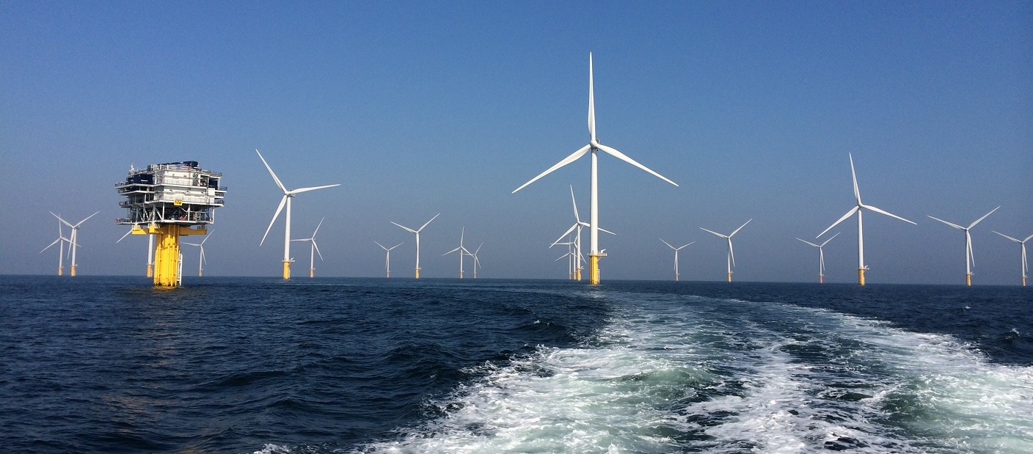
Offshore wind

Slide 22
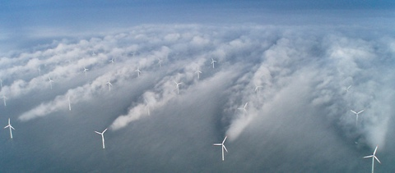
Offshore wind

Slide 23
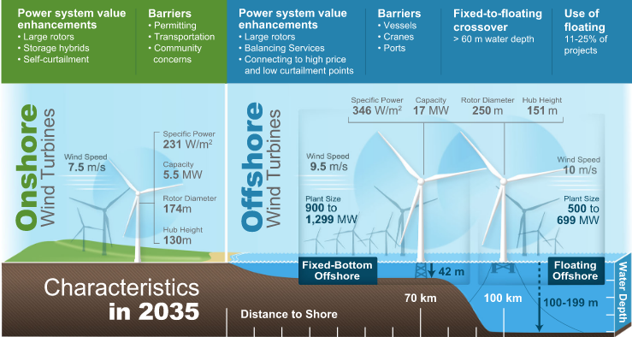
Offshore wind
Beiter et al., “Expert perspectives on the wind plant of the future”, Wind Energy. 2022;1-16

Slide 24
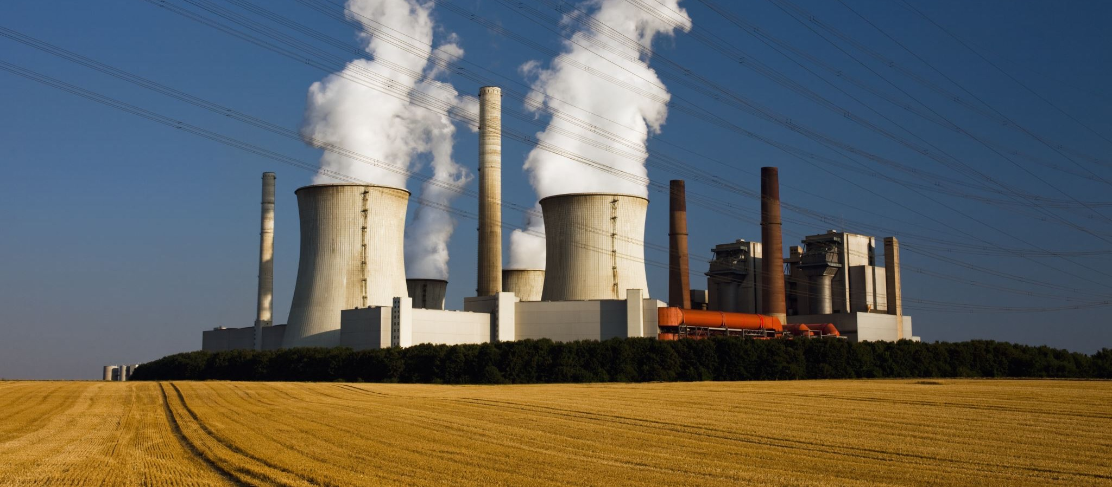
Thermal generation

Slide 25
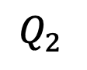

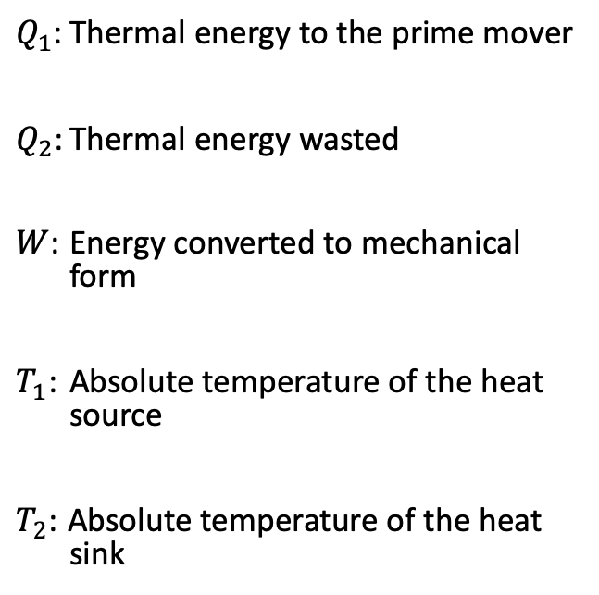
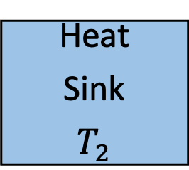
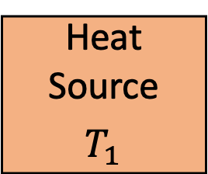
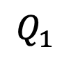
Heat engine
$Q_{1}$: Thermal energy to the prime mover
$Q_{2}$: Thermal energy wasted
$W$: Energy converted to mechanical form
$T_{1}$: Absolute temperature of the heat source
$T_{2}$: Absolute temperature of the heat sink
Heat Source
$$T_{1}$$
$$Q_{1}$$
Prime
Mover
Heat
Sink
$$T_{2}$$
$$Q_{2}$$
$$W$$
Mechanical Energy
Waste heat

Slide 26
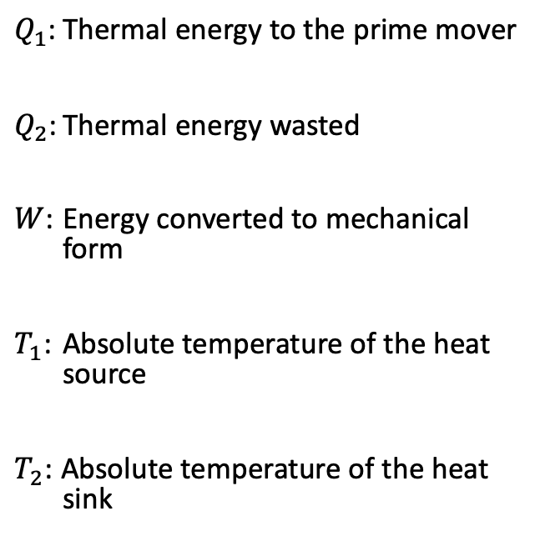
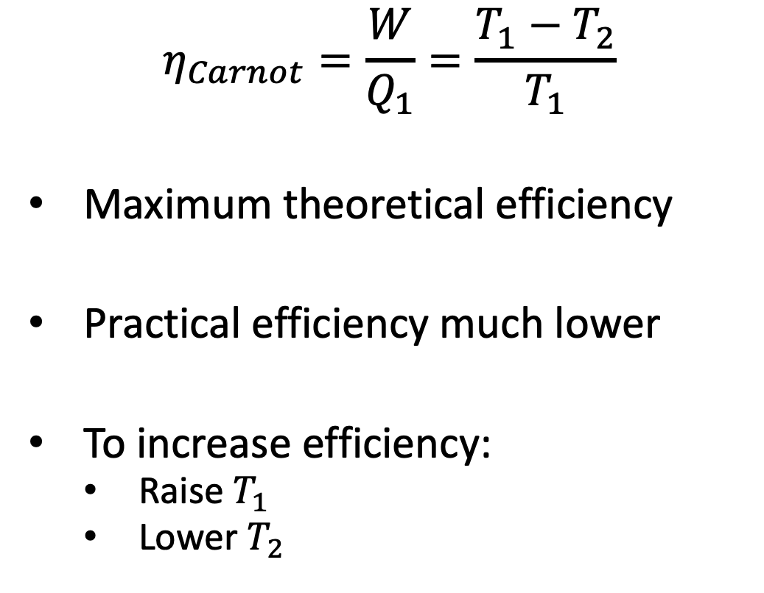
Carnot Efficiency
$$η_{Carnot}=\frac{W}{Q_{1}}=\frac{T_{1}−T_{2}}{T_{1}}$$
Maximum theoretical efficiency
Practical efficiency much lower
To increase efficiency:
Raise $T_{1}$
Lower $T_{2}$
$Q_{1}$: Thermal energy to the prime mover
$Q_{2}$: Thermal energy wasted
$W$: Energy converted to mechanical form
$T_{1}$: Absolute temperature of the heat source
$T_{2}$: Absolute temperature of the heat sink

Slide 27
Fossil-fueled steam plants
High pressure
water
High pressure
steam
Steam
turbine
Generator
Heat
source
Electrical energy
Steam
Generator
Pump
Boiler
Boiler
Condenser
Low pressure
steam
Fuel
(e.g., coal)
Low pressure
water
Heat
sink
Condenser is required because pressuring
steam requires much more energy
than pressuring water

Slide 28
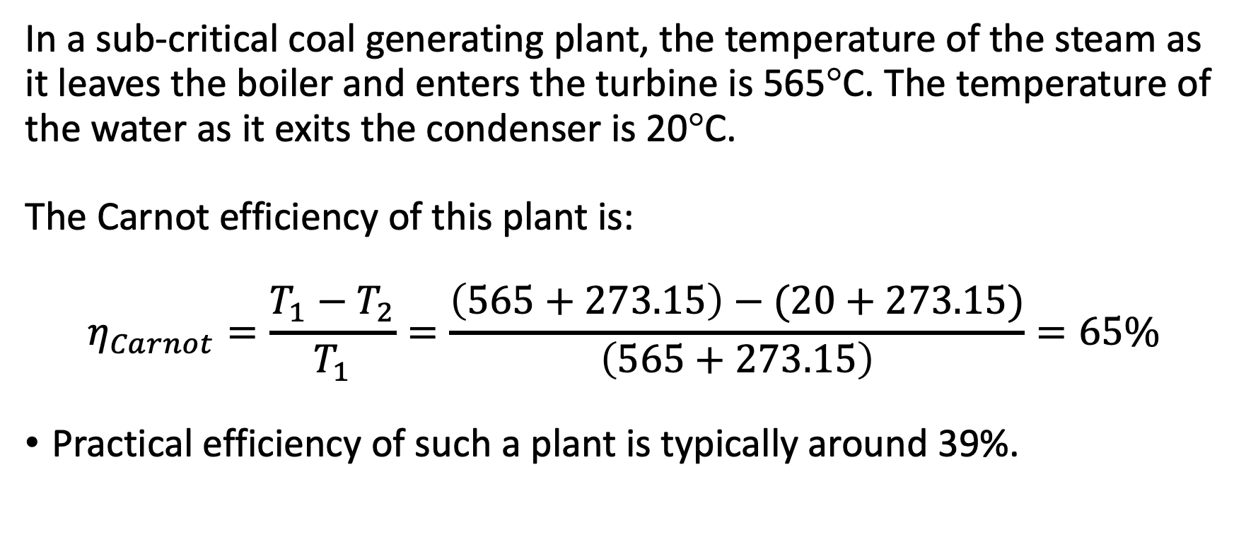
Example 3.1: Efficiency of a coal plant
In a sub-critical coal generating plant, the temperature of the steam as it leaves the boiler and enters the turbine is 565°C. The temperature of the water as it exits the condenser is 20°C.
The Carnot efficiency of this plant is:
$$η_{Carnot}=\frac{T_{1}−T_{2}}{T_{1}}=\frac{\left(565+273.15\right)−(20+273.15)}{\left(565+273.15\right)}=65\%$$
Practical efficiency of such a plant is typically around 39%.

Slide 29
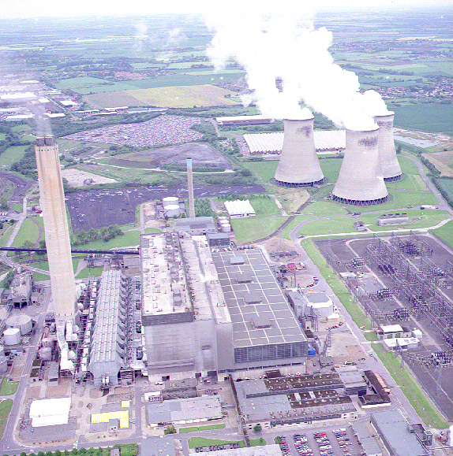
Coal power plant

Slide 30
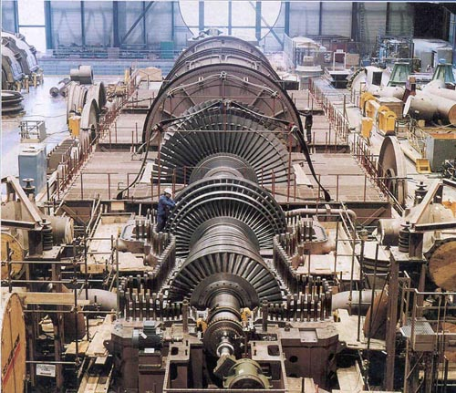
Steam turbine

Slide 31
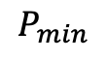
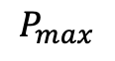
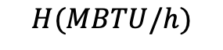
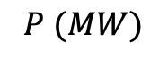
Input/output curve of a thermal power plant
$$H(MBTU/h)$$
$$P_{min}$$
$$P_{max}$$
$$P (MW)$$

Slide 32
Example 3.2: Heat rate and CO₂ emissions
According to the United States Environmental Protection Agency, the average, annual operating heat rate of U.S. coal-fired power plants is approximately 10,400 BTU/kWh.
To generate a constant 500 MW, a power plant would therefore have to produce 5.2 10⁹ BTU of heat every hour, which would require burning about 168,477 kg (371,429 pounds) of coal.
This plant would release 481,845 kg (1,062,360 pounds) of CO₂ each hour.

Slide 33
Nuclear power plants
Heat
Exchanger
Turbine
Generator
Steam
Generator
Boiler
Pump
Condenser

Slide 34
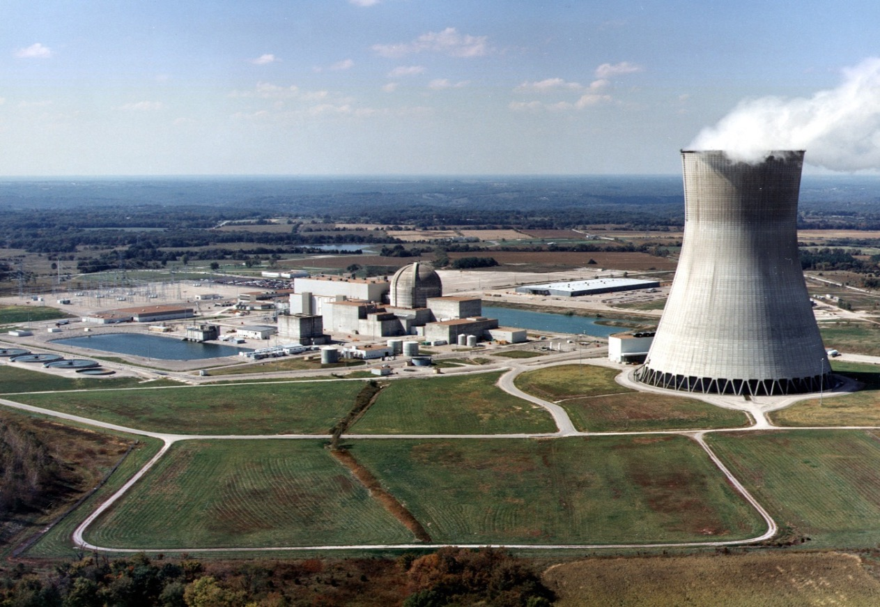
Nuclear power plant

Slide 35
Concentrated solar plant
Working fluid
Water
Hot Tank
Heat Exchanger
Steam
turbine
Generator
Receiver
Electrical energy
Cold Tank
Condenser
Heliostats
Pump

Slide 36
Combined heat and power plants - cogeneration
Steam
turbine
Generator
Electrical energy
Steam
Generator
Pump
Boiler
Heat
Recovery
District heating or
Industrial processes
Boiler
Fuel
Condenser

Slide 37
Open cycle gas turbine (OCGT)
Cold air at high
pressure
Hot air at high
pressure
Gas
Cold air at
atmospheric
pressure
Generator
Electrical energy
Combustion
chamber
Heat
sink
Compressor
Gas turbine
Exhaust gas at atmospheric pressure (still quite hot)
Heat
source
Cheap to build
Expensive to operate because inefficient
Highly flexible (fast start, quick ramp up and down)

Slide 38
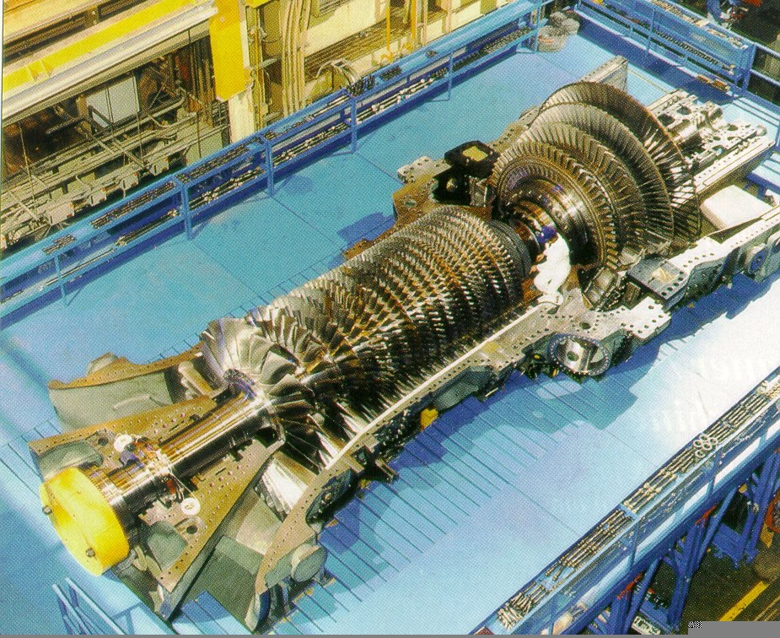
Gas turbine
Picture: General Electric

Slide 39
Combined cycle gas turbine (CCGT)
Gas
Generator 1
Electrical energy
Combustion
chamber
Compressor
Gas turbine
Exhaust - Heat source for steam cycle
Steam
Generator
Generator 2
Steam
Turbine
Electrical energy
High overall efficiency: 63%
Condenser
Pump

Slide 40
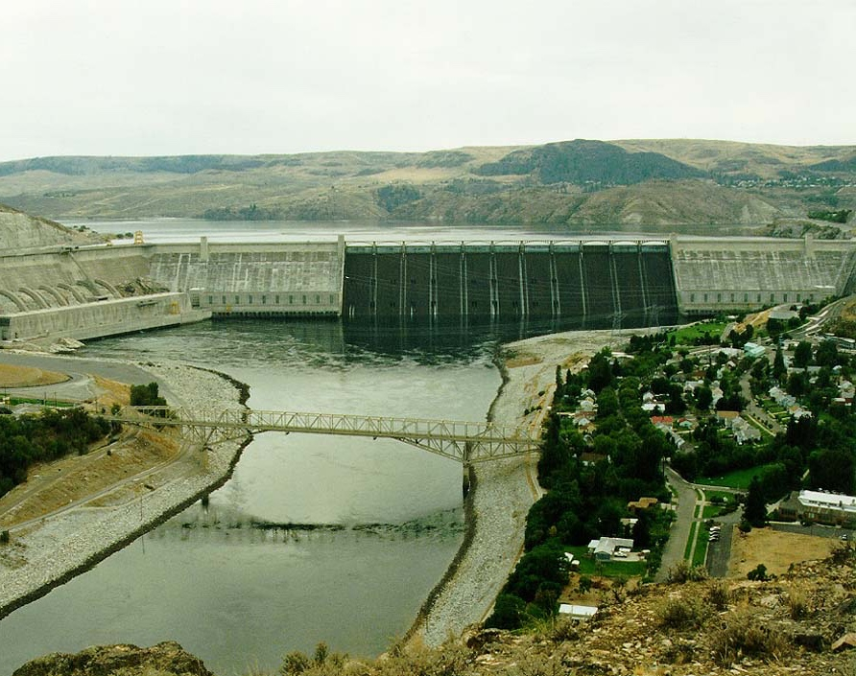
Hydroelectric generation
Grand Coulee Dam Washington State, USA

Slide 41


Impoundment hydro plants
Reservoir
Dam
Penstock
Gate
Head
Generator
Turbine
Tailrace
Discharge

Slide 42
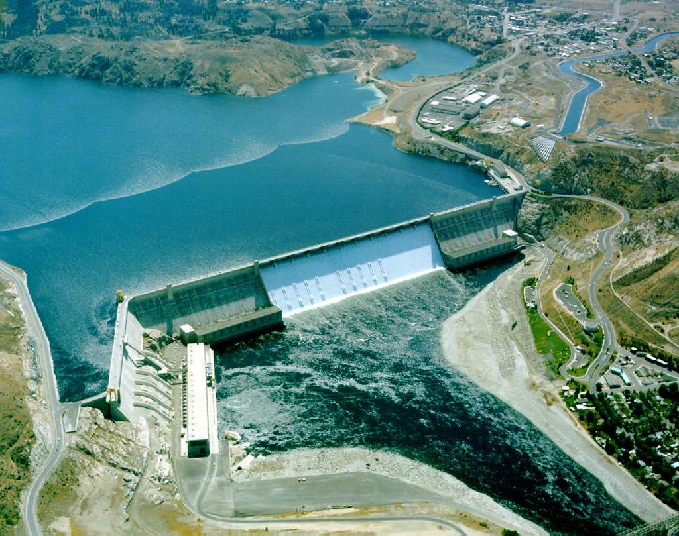
Grand Coulee Dam

Slide 43
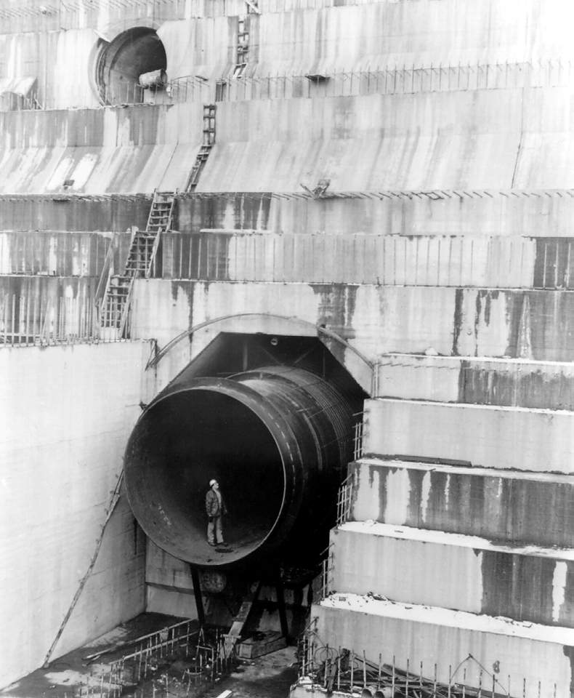
Tailrace of Grand Coulee Dam

Slide 44
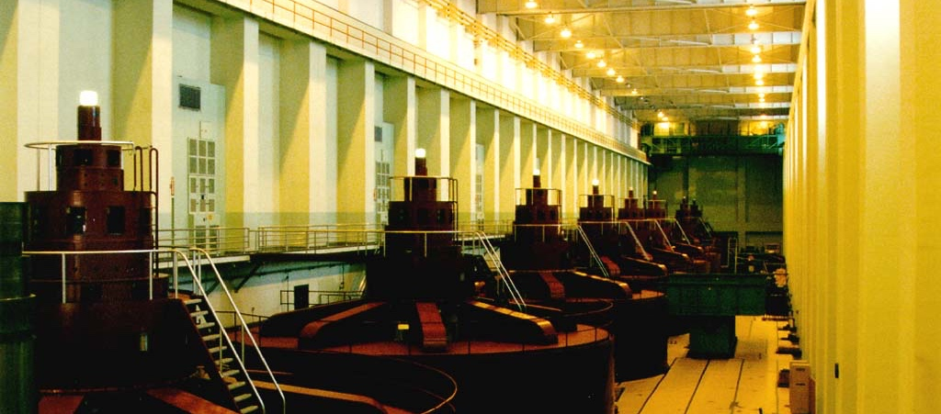
Turbine hall of Grand Coulee Dam

Slide 45
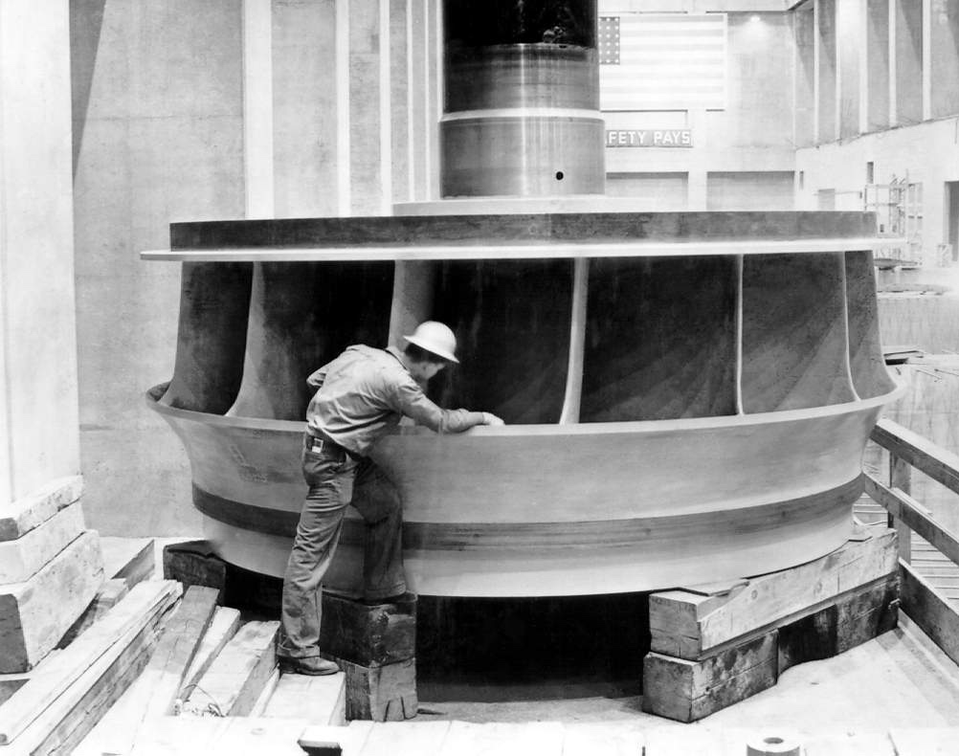
Francis turbine

Slide 46
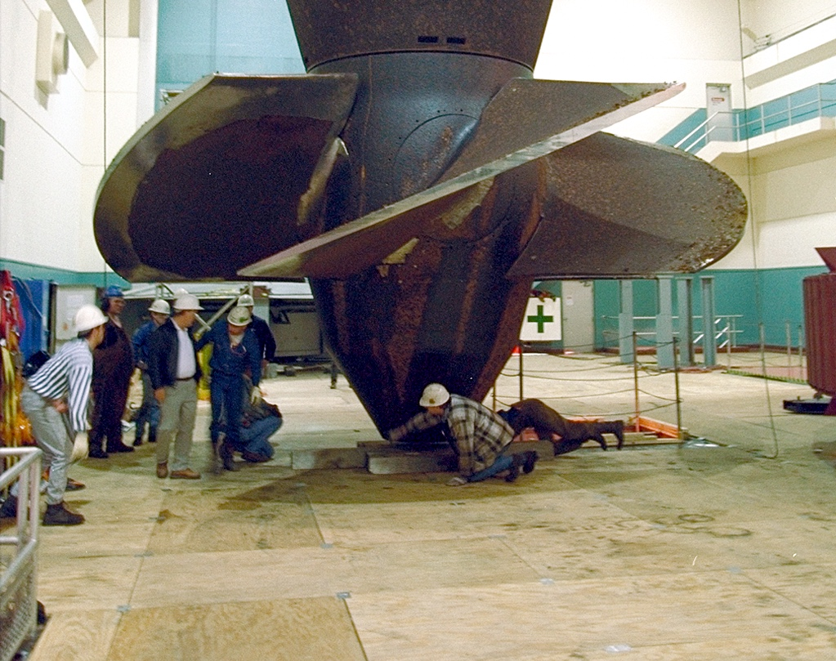
Kaplan turbine

Slide 47
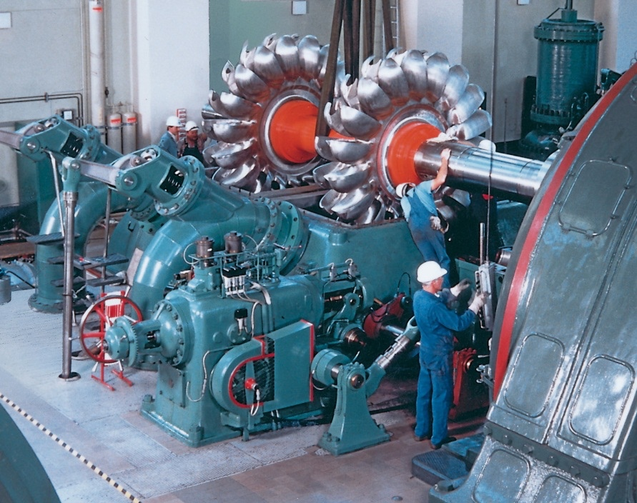
Pelton turbine

Slide 48

Three Gorges Dam on the Yangtze River

Slide 49
Itaipu Dam (Brazil & Paraguay)

Slide 50
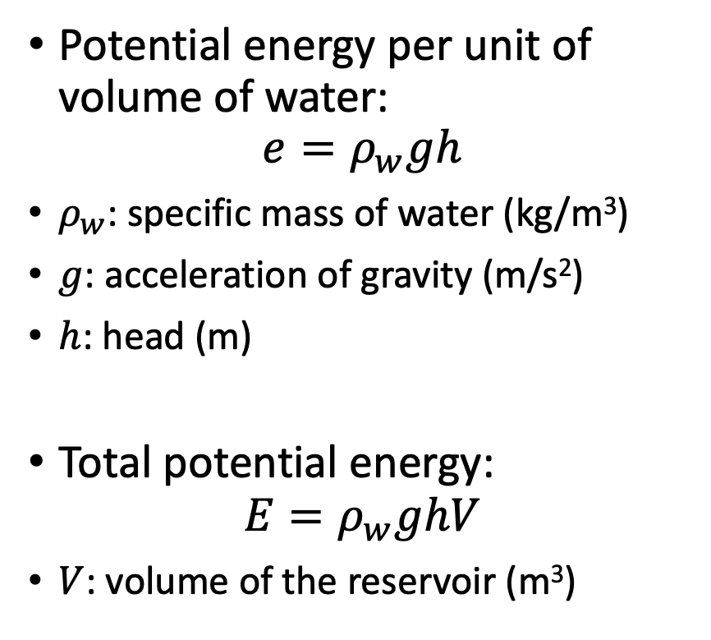
Energy in an impoundment reservoir
Potential energy per unit of volume of water:
$$e=ρ_{w}gh$$
$ρ_{w}$: specific mass of water (kg/m³)
$g$: acceleration of gravity (m/s²)
$h$: head (m)
Total potential energy:
$$E=ρ_{w}ghV$$
$V$: volume of the reservoir (m³)
Reservoir
Dam
Penstock
Gate
Head
Generator
Turbine
Tailrace
Discharge

Slide 51
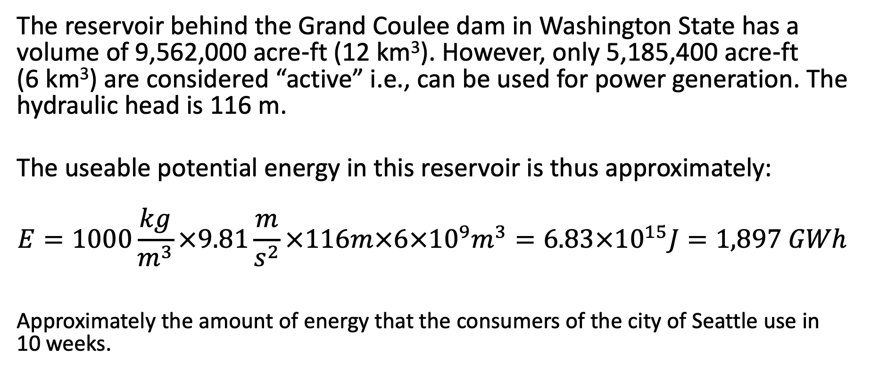
Example 3.3: Energy in a hydro reservoir
The reservoir behind the Grand Coulee dam in Washington State has a volume of 9,562,000 acre-ft (12 km³). However, only 5,185,400 acre-ft (6 km³) are considered “active” i.e., can be used for power generation. The hydraulic head is 116 m.
The useable potential energy in this reservoir is thus approximately:
$$E=1000\frac{kg}{m^{3}}×9.81\frac{m}{s^{2}}×116m×6×{10}^{9}m^{3}=6.83×{10}^{15}J=1,897 GWh$$
Approximately the amount of energy that the consumers of the city of Seattle use in 10 weeks.

Slide 52
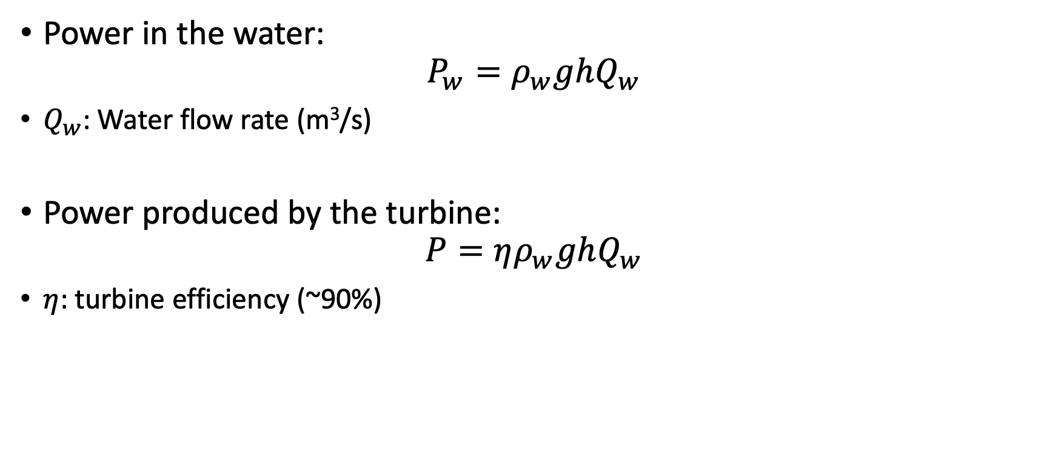
Power from a hydro plant
Power in the water:
$$P_{w}=ρ_{w}ghQ_{w}$$
$Q_{w}$: Water flow rate (m³/s)
Power produced by the turbine:
$$P=ηρ_{w}ghQ_{w}$$
$η$: turbine efficiency (~90%)

Slide 53
Controlling hydro power
Hydro is highly flexible
Quick start
Fast ramp up and ramp down
Turbine efficiency drops quickly when flow is off nominal
Install multiple small turbines
Operate each turbine at nominal flow or turn it off

Slide 54
Columbia river system
Operation of upstream dams affects the downstream dams
Environmental constraints
Effect on fish population
Interactions with other uses of water
Flood control
Irrigation
Transportation
Recreation
Scheduling hydro production is a very complex problem

Slide 55

Diversion hydro plants
“Run-of-the-river” hydro
Power production depends on water flow in the river
Much smaller environmental impact that impoundment hydro

Slide 56

Photovoltaic generation

Slide 57

Solar resources in the United States
Global horizontal
solar irradiance (W/m²)
Source: Sengupta, M., Y. Xie, A. Lopez, A. Habte,
G. Maclaurin, and J. Shelby. 2018. "The National Solar Radiation Data Base (NSRDB)."
Renewable and Sustainable Energy Reviews 89 (June): 51-60.

Slide 58

Solar cell
Sun
$$I$$
Load
N-Type
-
-
P-Type
Base

Slide 59








$I−V$ and $P−V$ characteristics of a solar cell
$$I, P$$
$$I_{SC}$$
Maximum power point
$$I^{∗}$$
$$P=V.I$$
$$V^{∗}$$
$$V_{OC}$$
$$V$$

Slide 60

Effect of irradiance on the $P−V$characteristic
2.4
2.1
1000 W/m²
1.8
800 W/m²
1.5
Power (W)
600 W/m²
1.2
0.9
400 W/m²
0.6
200 W/m²
0.3
0
0
0.1
0.2
0.3
0.4
0.5
0.6
Voltage (V)

Slide 61


Effect of temperature on the $P−V$characteristic
Source: https://www.pvresources.com/en/solarcells/solarcells.php

Slide 62
Maximizing solar generation
Maximum power point depends on:
Irradiance
Temperature
Operating at fixed voltage, fixed current or fixed resistance therefore does not maximize the efficiency of the cell.
Must adjust the voltage to track the maximum power point
See chapter on power electronics energy conversion
Each solar cell produces at best a small voltage and current
Connect cells in series to increase the voltage
Connect cells in parallel to increase the current

Slide 63

Example 3.4: PV array
A small PV array consists of two parallel columns of four panels connected in series. Each of these panels comprises 4 rows of 9 cells connected in series. Each cell produces a maximum of 2.5W at 0.5V. Calculate the voltage, current and power rating of this array.
The voltage in each row of a panel is $9×0.5=4.5V$.
The maximum power produced by each panel is $36×2.5=90W$.
The current produced by each panel is then: $I_{panel}=\frac{90}{4.5}=20A$.
Since each column of the array consists of four panels in series, the voltage rating of the array is:
$V_{array}=V_{panel}×4=18V$.
Since there are two columns in parallel, the current rating of the array is:
$$I_{array}=I_{panel}×2=40A$$
Finally, the power rating is given by:
$$P_{array}=V_{array}×I_{array}=18×40=720W$$

Slide 64
Solar tracking
Concept: rotate the solar panel to maximize irradiance
Horizontal axis rotation to track solar elevation
Vertical axis rotation to track solar azimuth
~50% of utility-scale solar installations use single-axis tracking
A few utility-scale solar installations use two-axis tracking
Remainder and most residential solar installations do not use tracking
Efficiency gain must be weighed against higher cost

Slide 65

Vertical axis tracking
Source: Vinaykumar8687 through Wikimedia

Slide 66

Horizontal axis tracking
Source: Vinaykumar8687 through Wikimedia

Slide 67

Energy storage

Slide 68
Pumped hydro plant
Upper Reservoir
Generating mode
Generator/Motor
Pumping mode
Turbine/Pump
Lower Reservoir
Power House

Slide 69
Pumped hydro plant
Large power ratings: 100’s to 1000’s of MW
Typically stores enough water to discharge at full MW capacity for 6-8 hours
Typical roundtrip efficiency 70-80%
Construction cost is large

Slide 70

Rocky Mountain Hydroelectric Plant (Georgia)

Slide 71

Hohenwarte II in Thuringia, Germany

Slide 72
Battery energy storage systems (BESS)
Battery Cells
dc
Power Conversion
System
ac
BMS
Controller
External
Commands

Slide 73
Battery energy storage systems
Battery cells arranged in series and parallel
Achieve suitable current and voltage ratings
Bidirectional power electronics converter
Battery management system (BMS)
Monitors currents, voltages, temperatures of the battery cells
Balance loading during charging and discharging
Maintain safe operating condition

Slide 74
BESS characteristics
Energy rating (MWh)
Power rating (MW)
Roundtrip efficiency (~80% typically)
State of Charge (SoC): percentage of energy rating available
Battery degradation
Typically, 75% of energy capacity remains after 10 years
C-rate
C = 1 means that a fully charged battery is discharged in one hour
Faster charge/discharge rates reduce the battery life

Slide 75

Example 3.5: Battery energy storage system
The BESS of Snohomish PUD’s Arlington microgrid is rated at 1MW, 1.38 MWh.
The cells are arranged in 11 parallel racks of 9 modules in series.
The voltage on the dc side varies between 1,126 V and 1,461 V depending on whether the battery is charging or discharging.
The voltage on the ac side is 630 V.
It is housed in a $23.3’×8’×9.6’$container that weighs 55,000 pounds.

Slide 76
Other energy storage technologies
Flywheels rotating at up to 100,000 rpm
Compressed air combined with gas turbines
Use surplus renewable energy to electrolyze water and produce “green hydrogen”.
Burning this hydrogen to generate electricity is not economically viable due to low thermodynamic efficiency.

Slide 77
Applications of energy storage
Arbitrage – “Buy low – Sell high”
Charge when renewable energy is abundant, and demand is low
Discharge when demand is high and renewable energy is scarce
Requires a large price difference to compensate for losses
Frequency regulation
Compensate for small fluctuations in load and generation
Reserve services
Compensate for a sudden loss of generation
Peaking generation
Provide power during periods of high demand

Slide 78

Choosing a generation technology

Slide 79
Factors affecting the choice of technology
Local availability of primary energy
Hydro, fossil fuel, nuclear, wind, solar
Self-reliance vs. imports
Mandates for use of renewable sources
Economic considerations
Profitability

Slide 80

A simple profitability calculation model
Simplifying assumptions:
Consider a single year
Ignore uncertainties
Profit $Γ$:
$$Γ=πE−C$$
$π$: sale price of electrical energy
$E$: amount of energy produced by the plant in one year
$C$: Cost of ownership of the plant
Annuitized investment cost + operating cost

Slide 81

Cost of ownership
$$C=c_{capacity}P+c_{energy}E$$
$P:$ capacity of the plant (MW)
$c_{capacity}$ in $/MW
$c_{energy}$ in $/MWh
$$E={8760 ×C}_{f}P=C_{h}P$$
$C_{f}$: Expected capacity factor of the plant
Annuitized
investment
cost
Operating
cost

Slide 82

Breakeven price
$$Γ=π C_{h}P−c_{capacity}P−c_{energy}C_{h}P$$
Profit per MW of installed capacity (ignoring economies of scale):
$$\frac{Γ}{P}=\left(π −c_{energy}\right)C_{h}−c_{capacity}$$
Energy price at which the plant breaks even:
$$π=c_{energy}+\frac{c_{capacity}}{C_{h}}$$

Slide 83

Competitiveness
$$π=c_{energy}+\frac{c_{capacity}}{C_{h}}$$
To be competitive, a technology with a high investment cost must have:
A low operating cost
A large capacity factor

Slide 84

Example 3.6: Breakeven energy prices
 | $c_{energy}$ ($/MWh) | $c_{capacity}$ ($/MW) | $$C_{f}$$ | $C_{h}$ (h) | $π$ ($/MWh)
Wind farm | 0 | 140000 | 40% | 3504.0 | 39.95
CCGT | 26.5 | 88200 | 87% | 7621.2 | 38.07

Slide 85

Levelized cost of energy (LCOE)
Combines more rigorously operating and investment costs
$LCOE=\frac{\sum_{t=0}^{N}{\frac{I_{t}+M_{t}+F_{t}}{{\left(1+r\right)}^{t}}}}{\sum_{t=0}^{N}{\frac{E_{t}}{{\left(1+r\right)}^{t}}}}$ ($/MWh)
$N$: expected life of the plant (years)
$I_{t}$: expected investment cost in year $t$ ($)
$I_{t}$: expected maintenance cost in year $t$ ($)
$F_{t}$: expected fuel cost in year $t$ ($)
$E_{t}$: expected energy production in year $t$ (MWh)
${\left(1+r\right)}^{t}$: discount factor to reflect the time value of money

Slide 86
LCOE estimates
Plant type | Capacity factor (%) | LCOE ($/MWh)
Ultra-supercritical coal | 85 | 76.44
CCGT | 87 | 38.07
OCGT | 30 | 66.62
Advanced nuclear | 90 | 74.88
Geothermal | 90 | 35.43
Biomass | 83 | 94.83
Wind, onshore | 40 | 39.95
Wind, offshore | 44 | 122.25
Solar photovoltaic | 29 | 33.12
Hydroelectric | 59 | 52.79
US EIA estimates of the unweighted LCOE for new generation resources entering service in 2025 (2019 dollars)
(Source: www.eia.gov/aeo/pdf/electricity_generation.pdf)

